Slide 1
Hashing: Collision Resolution, Deletion

Slide 2
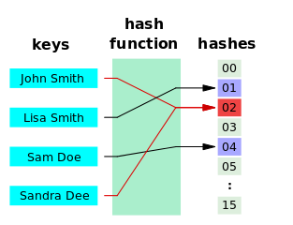
Collisions in Hashing
No matter how good the hash function is, there is always a chance of collision
We map a potentially unbounded space of inputs to a bounded table of entries
The more entries there are, and the smaller the table => the higher is the chance of collision
Should we try harder and invent a perfect hash function for all cases?
Can we perhaps devise an algorithm to resolve the collisions instead?

Slide 3
Collision Resolution
Simplest approach: if the cell addressed by the hash code is occupied, try another cell
But which cell must we try?
The key should still be easily accessible – can’t just use a random place
We need a formula that will derive the next possible position of K
hash(“James”) = 2
hash(“Jane”) = 2
Try another cell?
 |  | James
0 | 1 | 2 | 3 | 4 | 5 | 6

Slide 4
Collision Resolution
We need a formula that will derive the next possible position of K
Create a probing function p
If a collision occurred, try the positions in the probing sequence:
norm(h(K) + p(1)), norm(h(K) + p(2)), …, norm(h(K) + p(i))
i is a “probe”, i = {1, 2, 3, …, T - 1}
norm is a normalisation function, squashing the indexes to the allowed range (%)
hash(“James”) = 2
hash(“Jane”) = 2
Try another cell?
 |  | James
0 | 1 | 2 | 3 | 4 | 5 | 6

Slide 5
Linear probing
Use the identity function as the probe function: p(i) = i
33
16
27
23
26
79
88
(h(K) + 1)%T, (h(K) + 2) % T, …
0
1
2
3
4
5
6
7
8
9
Search the table sequentially until an open position is found
If the end of the table is reached, start from the top of the table
h(K) = K % 10
The search stops when the original position is reached

Slide 6
Linear probing
Problem with linear probing: colliding data will cause clusters
Clusters will cause more collisions!
0
1
2
3
4
5
6
7
8
9
0.1
0.1
0.1
0.1
0.1
0.1
0.1
0.1
0.1
0.1
0
1
2
3
4
5
6
7
8
9
33
0.1
0.1
0.1
0
0.2
0.1
0.1
0.1
0.1
0.1
12
0
13
0.3
0
0.4

Slide 7

Quadratic probing
Use a more complex probing sequence to avoid clusters:
p(i) = ${\left(−1\right)}^{i−1}{\left(\left\lfloor {i+1}/2\right\rfloor \right)}^{2}$ for i = 1,2,…,T – 1
What we are essentially trying to do:
Instead of going sequentially through i’s: 1,2,3,…
Go though i’s squares with alternating signs: 1, -1, 4, -4, 9, -9, 16, -16…
If a collision occurred, try the following:
( h(K) + $i^{2}$ )%T
( h(K) - $i^{2}$ )%T
for i = 1,2,…,(T – 1)/2
Does this approach avoid clusters?
(2 + 1) % 7 = 3
(2 + 1) % 7 = 3
(2 - 1) % 7 = 1
(2 + 1) % 7 = 3
(2 - 1) % 7 = 1
h(“Janet”) = 2
(2 + 4) % 7 = 6
h(“James”) = 2
h(“Jammie”) = 2
h(“Jane”) = 2
(2 - 4) % 7 = ?
(-2) % 7 = 7 – 2 = 5
Jane
Janet
 |  | James
Jack
Jammie
0 | 1 | 2 | 3 | 4 | 5 | 6
h(“Jack”) = 2

Slide 8
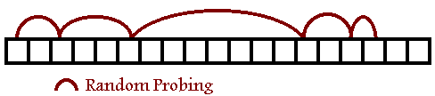
Randomized probing
Quadratic probing will generate similar sequences for different keys, resulting in secondary clusters, or meta-clusters
What if we generate a random sequence for each K?
No clustering!
But how are we going to find K in the table if it is placed randomly?
Solution: every K must use its own seed for the random number generator
Seed predetermines the sequence of numbers that the random number generator is going to produce
Use K itself as a seed
Or: use a numeric aspect of K, such as size, first byte, last byte, etc.

Slide 9
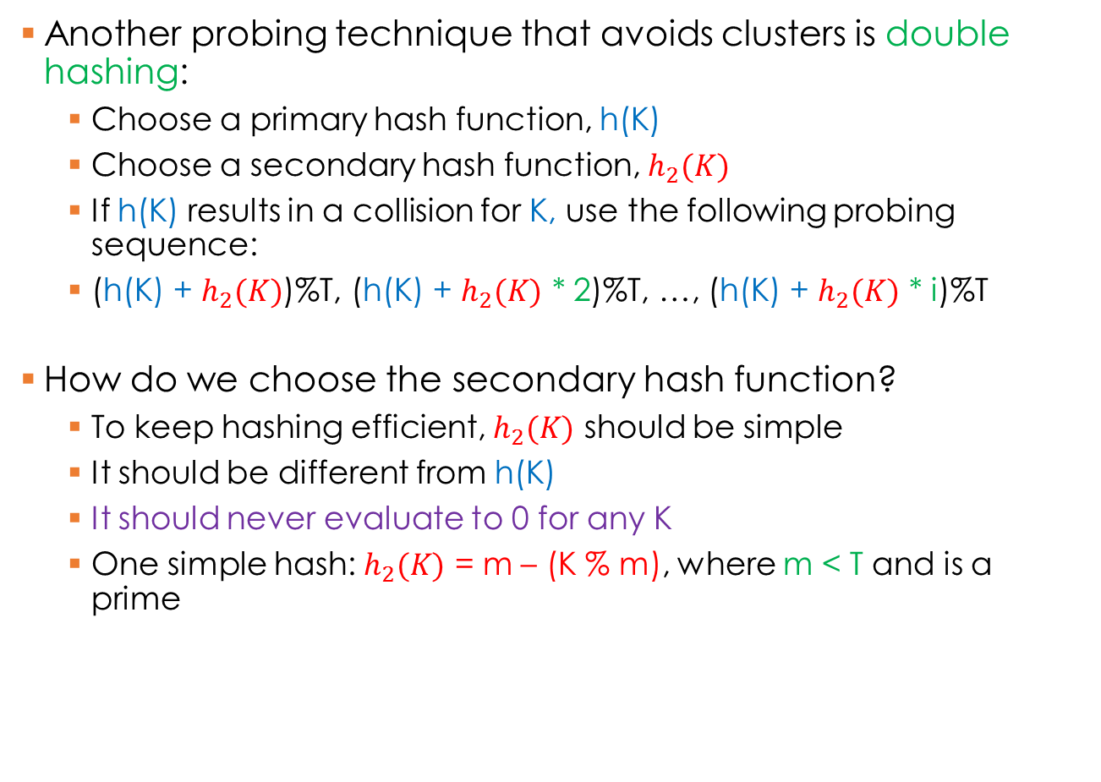
Double hashing
Another probing technique that avoids clusters is double hashing:
Choose a primary hash function, h(K)
Choose a secondary hash function, $h_{2}(K)$
If h(K) results in a collision for K, use the following probing sequence:
(h(K) + $h_{2}(K)$)%T, (h(K) + $h_{2}(K)$ * 2)%T, …, (h(K) + $h_{2}(K)$ * i)%T
How do we choose the secondary hash function?
To keep hashing efficient, $h_{2}(K)$ should be simple
It should be different from h(K)
It should never evaluate to 0 for any K
One simple hash: $h_{2}(K)$ = m – (K % m), where m < T and is a prime

Slide 10
Double hashing
33
16
27
23
46
79
38
0
1
2
3
4
5
6
7
8
9
h(K) = K % 10
h’(K) = 7 – (K % 7)
h’(23) = 7 – (23 % 7) = 5
(h(23) + h’(23))%10 = 3 + 5 = 8
h’(46) = 7 – (46 % 7) = 3
(h(46) + h’(46))%10 = 6 + 3 = 9
h’(79) = 7 – (79 % 7) = 5
(h(79) + h’(79))%10 = 14%10 = 4
h’(38) = 7 – (38 % 7) = 4
(h(38) + h’(38))%10 = 12%10 = 2

Slide 11
Chaining
What’s the problem with probing?
If a lot of collisions occur, you loose the benefit of direct access
Before the item is accessed, you have to find where it ended up as a result of avoiding collisions
What if, instead of resolving collisions, we stored multiple keys per one hash code?
Use a linked list
Efficient if collisions are few
Disastrous if collisions are many
h(K) = K % 10
33
16
27
23
26
79
88
0
1
2
3
4
5
6
7
8
9

Slide 12
Coalesced hashing
Trade-off solution: combine probing with chaining
Use linear (or any other) probing to find the next available position
Store the index of that position next to the position where the collision occurred
Now we can go to the next key without re-calculating the hashing sequence
If many collisions occur, this is still not very efficient
Linear probing is prone to clusters, clusters will yield longer chains…
h(K) = K % 10
33
16
27
23
26
79
88
0
1
2
3
4
5
6
7
8
9
-1
-1
-1
4
-1
-1
-1
8
-1
-1
-1
0
-1

Slide 13
Coalesced hashing with a cellar
Reserve part of the table for collision (overflow) data
This subset is called “the cellar”
All overflow goes into the cellar until the cellar is full
If cellar is full, resort to probing again
An appropriately-sized cellar can be efficient, and will not cause clustering!
h(K) = K % 10
0
1
2
3
4
5
6
7
8
9
10
11
12
-1
-1
33
16
27
23
26
79
13
-1
-1
10
-1
-1
-1
11
-1
-1
-1
-1
12
Cellar
-1
-1

Slide 14
Bucket addressing
Similar to chaining: store multiple keys in one row
A row is a “bucket” that has enough space for multiple keys
If a bucket overflows: use probing, or store a pointer to the overflow location
0
1
2
3
4
5
6
7
8
9
33
16
27
23
26
13
0
1
2
3
4
5
6
7
8
9
33
16
27
23
26
13
…
h(K) = K % 10

Slide 15
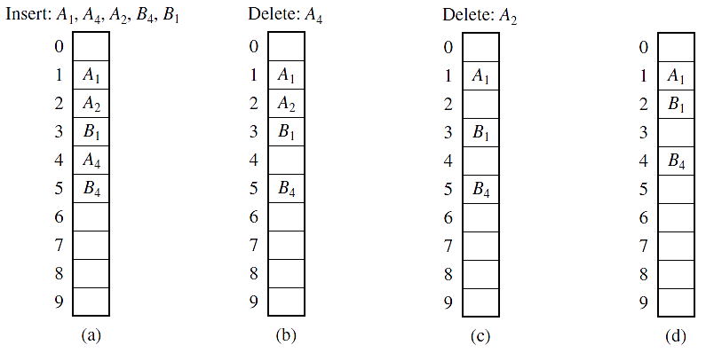
Deletion from a hash table
If hashing is perfect: just calculate the hash and delete the corresponding item!
If chaining is used: find the key to be deleted in the chain, remove, reconnect the chain
Similar to linked list deletion
What if simple probing was used?
Label deleted keys as deleted, but do not remove
Look for B1
Look for B4
Wasteful!
Not in the table!
After a certain number of deletions, reorganise
(rehash) the table
Not in the table!
Two items are “lost”

